Slide 2
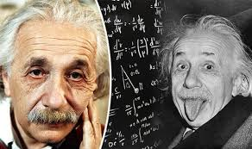
Interior for a Fun Classroom in Mathematics
Dear students, dear learners, dear friends!
Math can be a difficult subject, but it is something that everyone is capable of mastering. Math is based on LOGIC and RULES that you can study and apply – there isn’t any special skill involved. The subject might come easier to others than you feel it does to you, but if you practice and try hard you’ll also be good at math.
According our project colleague Andreas Skotinos from Cyprus, It is generally agreed that doing mathematics is a critical skill for all, adults and children, geniuses and people with limited intelligence, persons with high education and individuals with low literacy and knowledge.
According the great Albert Einstein, EVERYBODY IS A GENIUS. But if you judge a fish by its ability to climb a tree, it will live its whole life believing that it is stupid.

Slide 3
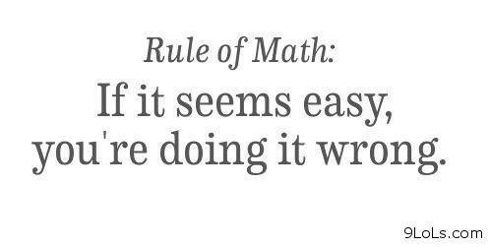
Interior for a Fun Classroom in Mathematics
Dear students, dear learners, dear friends!
This is a true - EVERYBODY IS A GENIUS!
But never forget this:

Slide 4
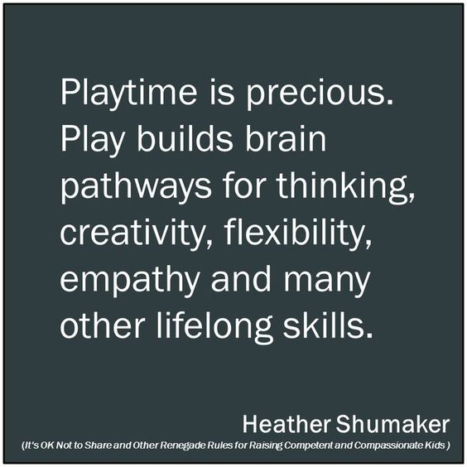
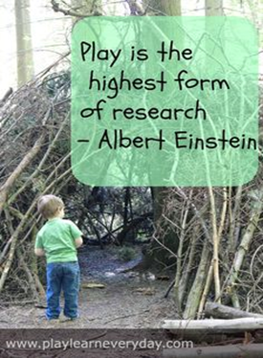
Interior for a Fun Classroom in Mathematics
Hey guys!
Do you play games in your classroom? Wait... what?! No time? Well... you should make time! Especially during your math time.
Do you know, math and games can go together like Nutella and pretzels. Delicious separate, but amazing together.
This is true for every person either a child or an adult.

Slide 5
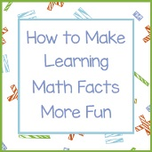
Interior for a Fun Classroom in Mathematics
There are so many questions at a practical level. For ex.:
How to Make Learning Mathematics more fun?
In Psychology it is recognized that Play brings joy.
How to understand Math much better?
You say that one way is to learn mathematics through play? But why is that so?
Indeed, the traditional games are a great way to learn Addition and Subtraction e.g. Play games with simple math. You only play for ex. to 100 so the numbers never get too high, but it’s a great way to learn basic addition. It’s much better than doing addition tables for hours!

Slide 6
Interior for a Fun Classroom in Mathematics
Today we will do 2 things within the subject “HOW TO UNDERSTAND MATHEMATICS MUCH MORE”.
First of all, we will arrange “A FUN CLASSROOM IN MATHEMATICS".
In it we will perform the role of… walls, hangers and other design solutions.
We'll get stuck with special badges, and some of us will wear “fun math t-shirts”.
Everyone can comment your own „interior” ☺
Secondly, we will run a long-forgotten Bulgarian game that can be played by a different number of people. It's called "Combination 9". It is not from the so-called "easy games" and introduces us to the world of Combinatorics.
As a Math game, it was developed for the first time by the KRUG Foundation with the help of mathematicians from the Bulgarian Academy of Sciences and was published in our 2 project books.

Slide 7
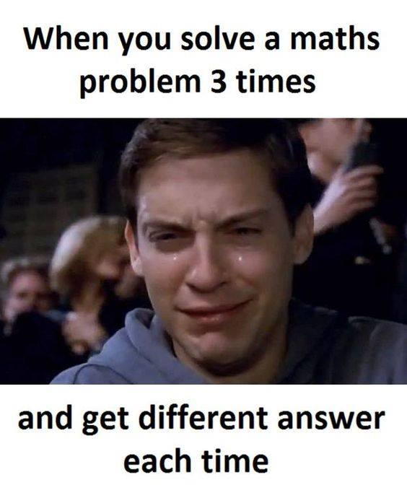
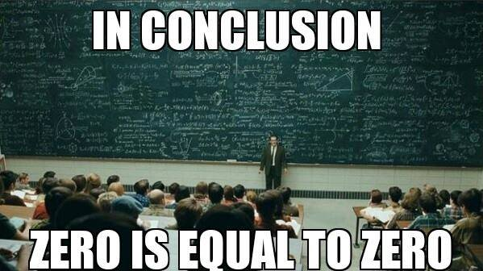
Interior for a Fun Classroom in Mathematics
CORRESPONDING QUESTIONS OF THE LECTURER in this process:
How would you comment this situation?
Do you think this is true?
Do you like this quote as a part of a Math lesson?
Do you agree with this statement?
Have you been in a situation like this:
Please, „decorate” yourself and a classroom with the „interior devices”, which are the fun introduction to our lesson! …and comment them, please…

Slide 8
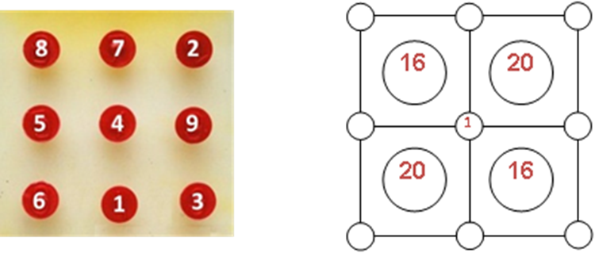
COMBINATION 9 – the Game starts now!
Make groups of 2 to 4 participants and select 2 jury members.
You will get worksheets and carnets and digits from 1 up to 9.
The scheme is a square divided by 4 with numbers from 1 to 27.
The goal of your teams is to use the numbers to get the sum of combinations of inner squares.
Anyone who plays must be able to collect up to 27.
If your teams have difficulties to sum and combine numbers, you have to divide the lesson into two lessons - First lesson: sum numbers; Second lesson: rearrange numbers.

Slide 9
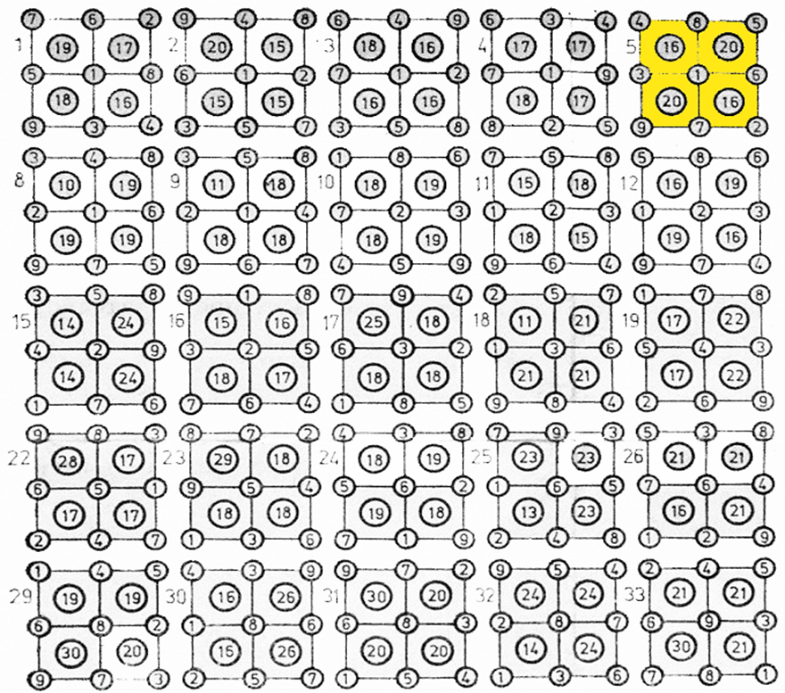
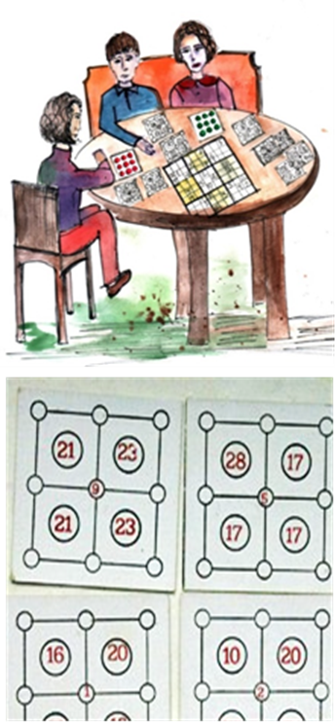
COMBINATION 9 – you see solution of some examples of carnets /giving a hint/

Slide 10
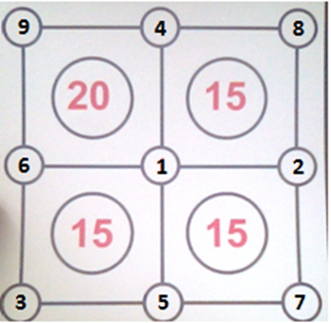
COMBINATION 9 – who is the Winner?
Players must be able to sum and combine numbers quickly from 1 to 9 in order to place them in the right places.
The jury members has to check if they have done well.
Whoever has succeeded in arranging them for the shortest time is the winner.

Slide 11
Thank you, dear learners! You were really great!

